Slide 1
Cross-cultural communication in GDs: Navigating Cultural Diversity in Group Settings
Martha Karunakar
18.08.2026

Slide 2
Cross-cultural communication
Cross-cultural communication refers to the exchange of ideas, information, and meaning between people from different cultural backgrounds.
In a Group Discussion (GD), participants may differ in:
Language and accent
Communication styles
Social norms
Attitudes toward authority
Approaches to disagreement

Slide 3
In a Group Discussion (GD), participants may differ in: (contd)
Attitudes toward authority
Approaches to disagreement
Levels of directness
Listening and turn-taking habits
Individual versus group orientation
Effective communication in a diverse group is not simply about speaking good English; it is about understanding how culture influences the way people speak, listen, disagree, persuade, and interpret others.

Slide 4
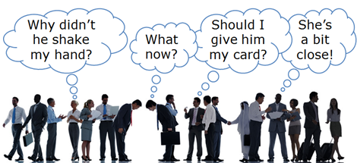
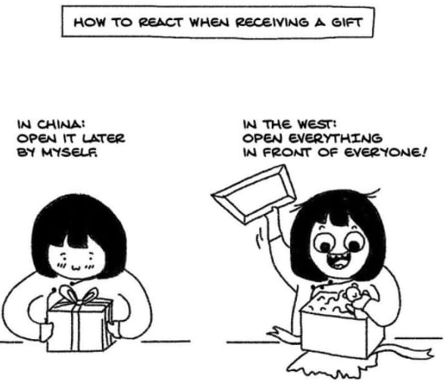
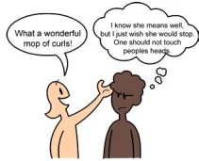

Slide 5
Cross-cultural competence
Williams (2001) defined cultural competence as "the ability of individuals and systems to work or respond effectively across cultures in a way that acknowledges and respects the culture of the person or organization being served"
Cultural intelligence is the ability to interpret the stranger's behavior the way the stranger's compatriots would (Muzychenko 2008). If employees don't feel as if their manager understands or respects their culture, employees may find it hard to trust the leader or work as a team.
Having cross-cultural competence means you can be effective in your interactions with people from most any culture.
Cross-cultural competence helps you develop the mutual understanding and human relationships that are necessary for achieving your professional goals.

Slide 6
Managing Disagreement Across Cultures
Disagreement is inevitable in a GD: The objective is not to eliminate disagreement, but to make disagreement productive.
Useful expressions
Agreeing
“I agree with your point because…”
“I would like to build on that idea.”
“That's an interesting perspective.”
Partially agreeing
“I agree to some extent, but I would also consider…”
“That is a valid point; however…”

Slide 7
Managing Disagreement Across Cultures
Disagreeing respectfully
“I see the issue somewhat differently.”
“I understand your argument, but I would suggest another interpretation.”
“Could we also consider the possibility that…?”
Clarifying
“Could you elaborate on that point?”
“If I understand you correctly, you are suggesting that…?”

Slide 8
The "3 Cs" of Cross-Cultural GDs
A useful framework for students:
Curiosity
Ask rather than assume.
Clarity
Make your meaning explicit and seek clarification.
Consideration
Recognise that others may have different communication norms.
Curiosity prevents assumptions.
Clarity prevents misunderstandings.
Consideration builds inclusion.

Slide 9
Major Challenges in Cross-Cultural GDs
Language Differences: Participants may have different levels of proficiency in the language used for the discussion.
Possible problems:
Difficulty finding the right words
Accent-related misunderstandings
Fear of making grammatical errors
Unequal participation
Misinterpretation of expressions or idioms

Slide 10
Develop Cultural Awareness
Learn about other cultures: Understand different cultural norms, values, and traditions. Study how people from different cultures communicate, including verbal and non-verbal cues.
Be open-minded: Acknowledge that your cultural perspectives are not universal. Approach cultural differences with curiosity and respect.

Slide 11
Enhance Active Listening
Listen attentively: In cross-cultural communication, misunderstandings can occur easily. Pay close attention to both what is being said and the context in which it’s said.
Be patient: People from different cultures may express themselves more slowly or differently. Avoid interrupting and allow space for the other person to communicate their thoughts fully.

Slide 12
Adapt Your Communication Style
Be mindful of language barriers: Speak clearly and avoid jargon or idioms that might confuse someone who is not familiar with your language. Use simple and direct language when possible.
Adjust to non-verbal cues: Different cultures have different interpretations of body language, facial expressions, and personal space. Be observant of the other person's non-verbal signals and adjust accordingly.

Slide 13
Show Respect for Cultural Differences
Acknowledge different perspectives: Understand that people from different cultures might have varying worldviews. Respect these differences without making judgments.
Avoid stereotyping: Don’t assume that everyone from a specific culture behaves or thinks the same way. Embrace individuality within cultural groups.

Slide 14
Seek Feedback and Learn from Mistakes
Ask for feedback: If you're unsure about something in cross-cultural communication, ask for feedback from someone with cultural expertise or the person you are communicating with.
Learn from missteps: If a misunderstanding or mistake occurs, acknowledge it and use it as an opportunity for learning and growth.

Slide 15
Practice Empathy
Put yourself in others’ shoes: Try to understand the feelings, thoughts, and perspectives of people from different cultures. This empathy can help you communicate more effectively and build better relationships.

